Slide 1
Tutorial 3 extra notes
jeremychoo@u.nus.edu

Slide 2
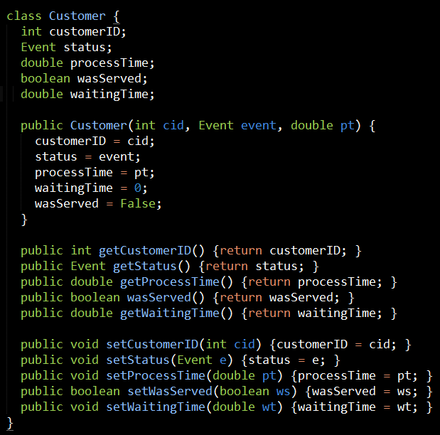
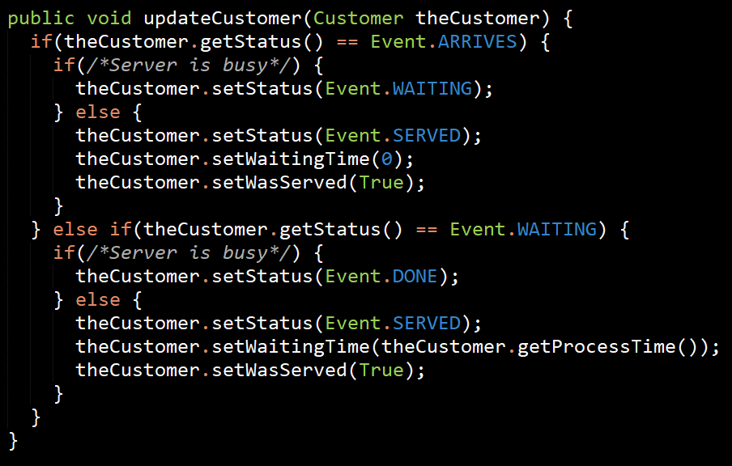
Classes, not structures

Slide 3
OOP: Step 2
Access and modify classes through behaviours, not by modifying their attributes
You’ve learnt how to identify classes, you can move on to identifying methods that should go into the class
Common tasks:
Arrives
Getting served
Leaving
If in doubt, look for the places where you’re utilizing these getters and setters.

Slide 4
Reading exceptions
Exception in thread "main" java.lang.NullPointerException
at Event.toString(Event.java:22)
at RunEvent.toString(RunEvent.java:133)
at Main.main(Main.java:35)
Exception in thread "main" java.lang.ArrayIndexOutOfBoundsException:
at Main.main(HelloWorld.java:18)

Slide 5
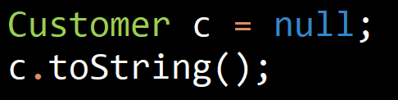
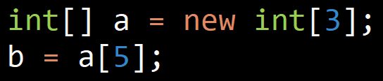
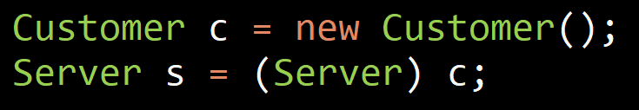
Exception in thread "main" java.lang.NullPointerException
NullPointerException (NPE)
It means you tried to manipulate an object that was actually null.
Some other common exceptions you might encounter:
ArrayIndexOutOfBoundsException
ClassCastException
Not sure what it means? Ask Google!

Slide 6
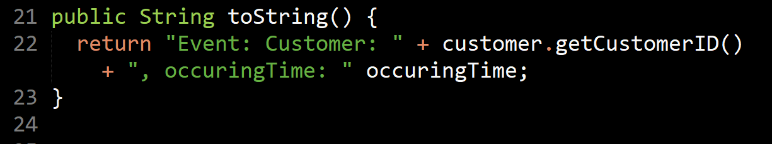
Stacktrace
at Event.toString(Event.java:22)
at RunEvent.toString(RunEvent.java:133)
at Main.main(Main.java:35)
Think of it like a stack
First line represents where the error occurred
Next few lines are where the previous method was called

Slide 7
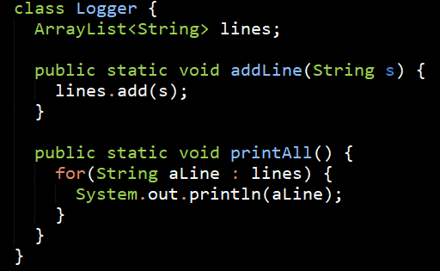
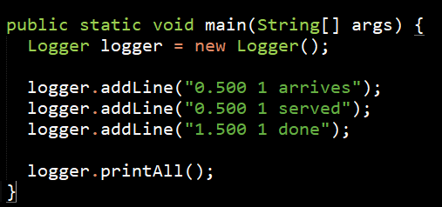
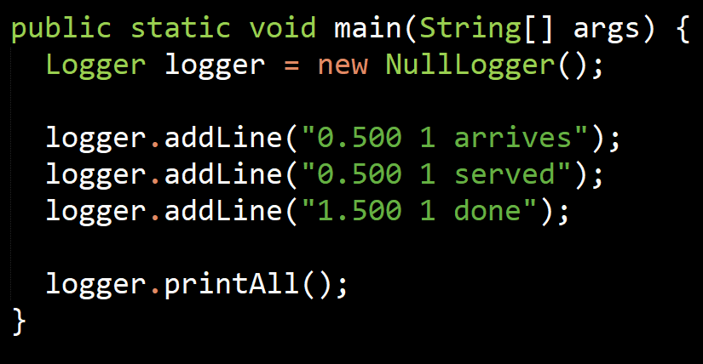
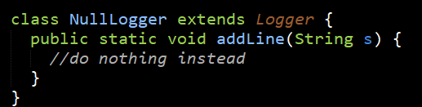
Does this break LSP?
$ echo "Hello World" > /dev/null

Slide 8
Does this break LSP?
Strictly speaking, yes.
A class breaks LSP if it you can’t take an instance of a subclass, treat it entirely like it’s superclass and expect it to work in the same way.
In this case, NullLogger doesn’t actually do the Logging actions of Logger.
it theoretically breaks LSP but not many languages support better solutions so we settle for what we have
You either follow LSP purely and "split" the class hierarchy or you just settle for this more pragmatic structure

Slide 9
Other topics
Running out of ideas
Anything you aren’t sure of?

